Slide 1

UNIVERSITY OF GHANA, LEGON (All rights reserved)
GROUP 2
Members
MICHELLE OWUSU – 10957340
MENSAH NYANYO HUBERT - 10976127
ANANE GEORGE NYARKO - 10947340
DERY-KUUZUME SANDRA - 10986424
APPIAH YAW FRIMPONG - 10987818
BENTIL B. REXFORD – 10946257
EVANS ACHEAMPONG - 10987644

Slide 2
Developing a Database for the Engineering School (SES)
Purpose: To automate some activities in Engineering School at the University of Ghana.
Objectives: To capture student details, register courses, register for examinations, print registered courses and examination results, add time table and exam time table.

Slide 3
Gathering Information
Information source: The Dean's office
Data required: Student details, course information, examination information, time table information
Method of data collection: Interview, survey, observation
Sources: Dean, Registrar, IT department, department heads, and staff members.
Challenges: Incomplete or inaccurate data

Slide 4
Identifying Entities
Entities: Student, Course, Examination, Time Table, Lecturer
Definition of entities
Student: A person who is enrolled in the Engineering School
Course: A subject or module that is offered in the Engineering School
Examination: An assessment taken by a student to evaluate their knowledge and understanding of a course
Time Table: A schedule of classes and other academic activities
Lecturer: A person who teaches a course in the Engineering School

Slide 5
Student entity attributes: ID number, name, date of birth, email address, phone number, gender.
Course entity attributes: Course code, course name, course credit hours.
Lecturer entity attributes: Lecturer ID, name, email address, phone number.
Examination entity attributes: Examination ID, examination date, examination time.

Slide 6
Entity Relationship Diagram
An Entity Relationship Diagram (ERD) is a visual representation of the entities and their relationships
ERD for the Engineering School Database
Student (1) -> (many) Course
Course (many) -> (many) Lecturer
Course (many) -> (many) Examination
Time Table (1) -> (many) Course
Examination (1) -> (1) Course
Examination (1) -> (many) Student
Student (1) -> (many) Examination

Slide 7
Relationships identified:
A student takes one or more courses.
A course is taken by one or more students.
A course is taught by one lecturer.
A lecturer teaches one or more courses.
An examination is taken by one or more students.
A student takes one or more examinations.
Relationship descriptions:
One-to-many relationship between student and course.
Many-to-many relationship between course and lecturer.
One-to-many relationship between student and examination.

Slide 8
Identifying Attributes
Data types:
ID number: integer Examination time: varchar
Name: varchar Examination date: date
Date of birth: date Examination ID: integer
Email address: varchar Lecturer ID: integer
Phone number: varchar Course credit hours: integer
Gender: varchar Course name: varchar
Course code: varchar

Slide 9
Entity Relationship Diagram (ERD)
ERD presented visually
Entities represented as boxes, relationships represented as lines, and attributes represented as ovals.
Student entity connected to Course entity through one-to-many relationship.
Course entity connected to Lecturer entity through many-to-many relationship.
Student entity connected to Examination entity through one-to-many relationship.

Slide 10
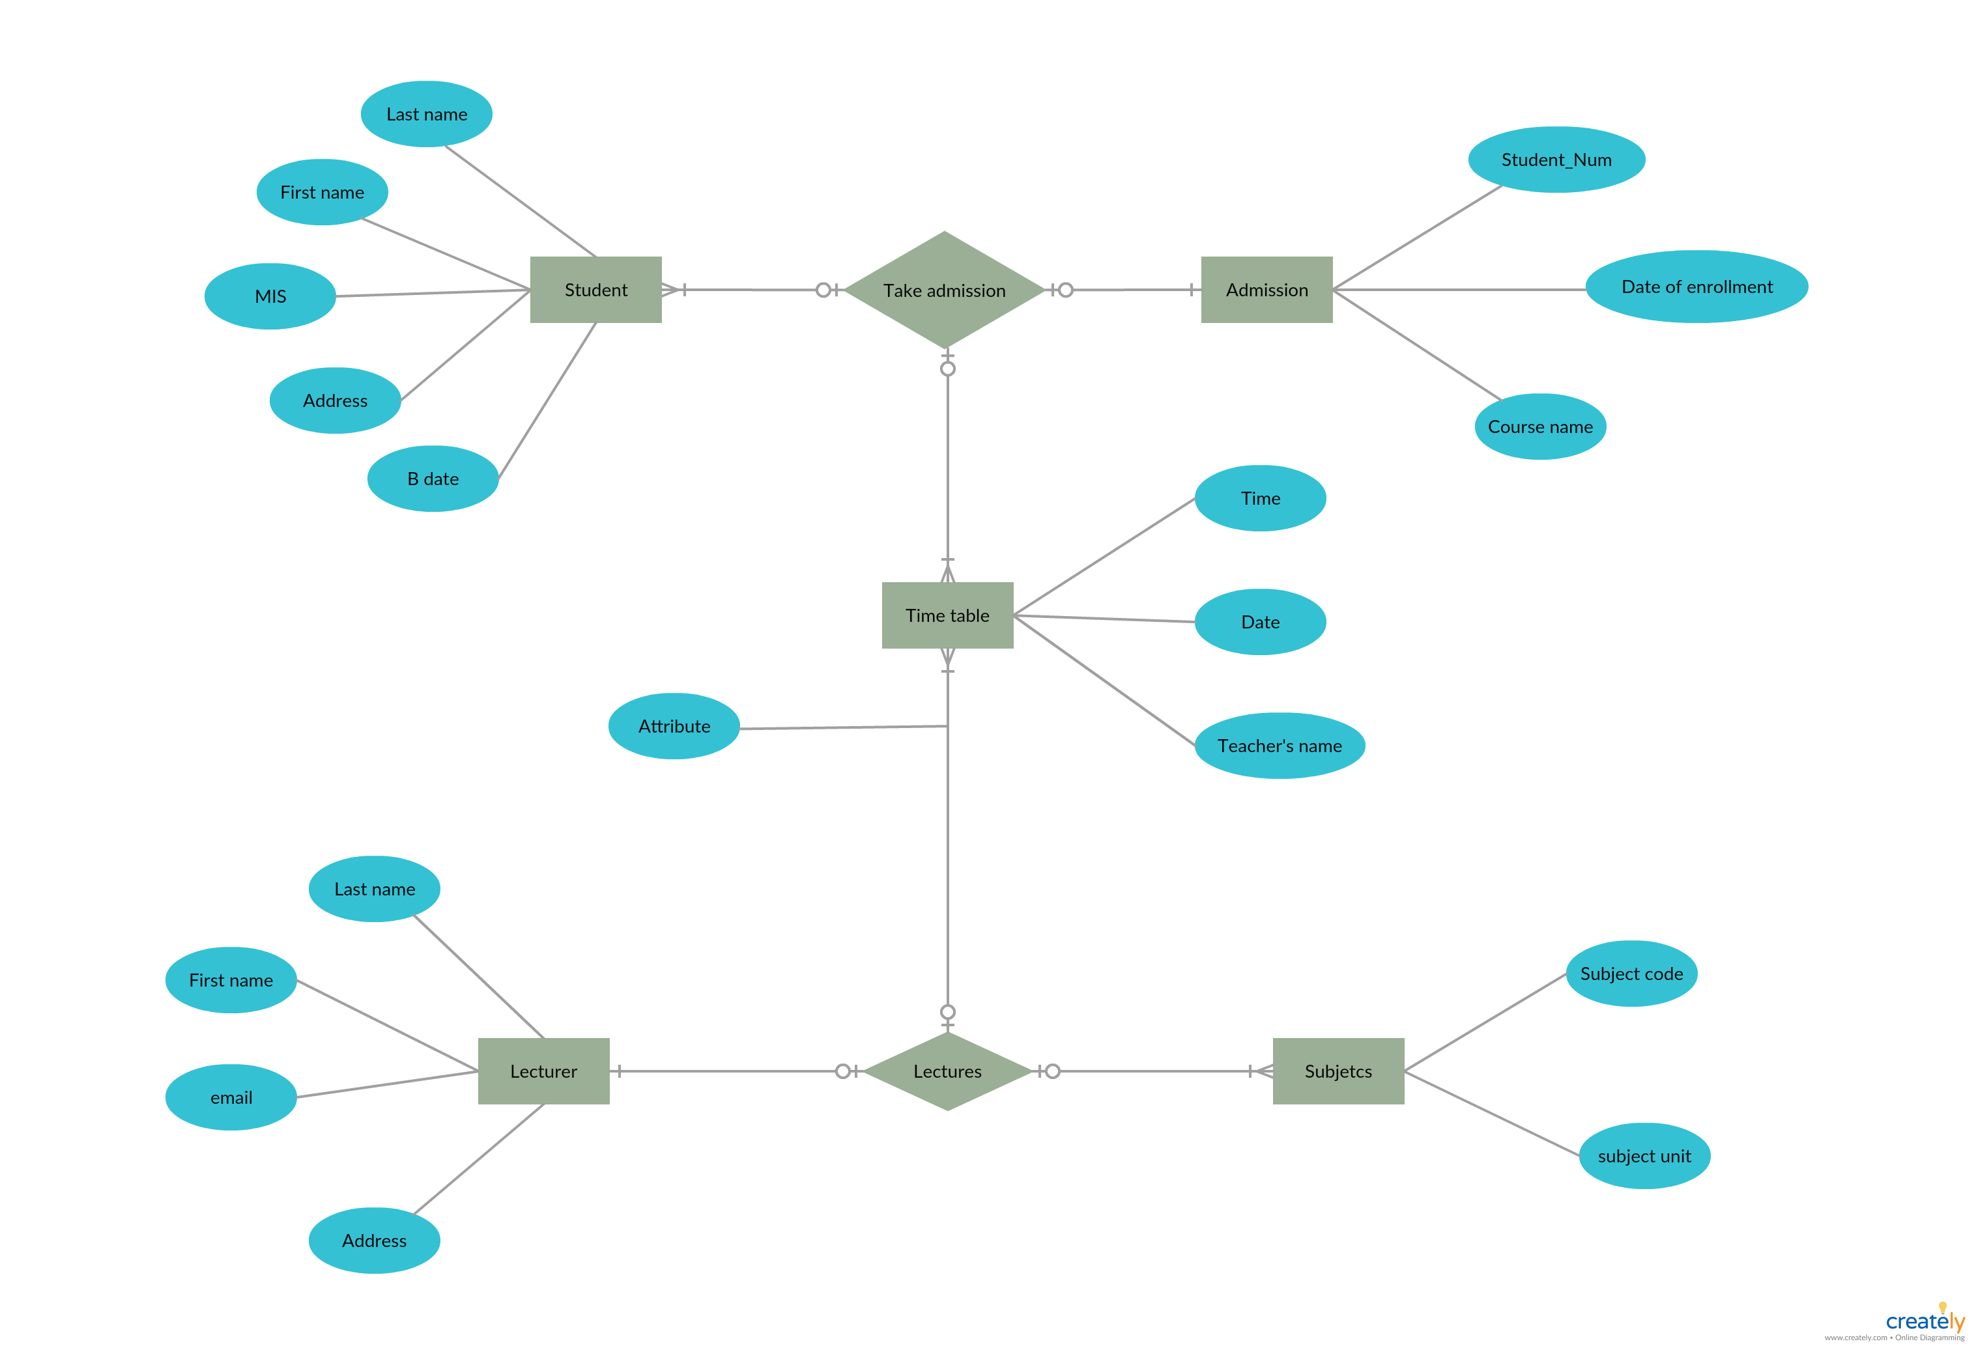

Slide 11
Creating the Database
Database created using Postgres.
Tables created for each entity in the ERD.
Relationships defined between tables through foreign keys.
Modifications made to the ERD during database creation process, such as adding additional attributes or entities.

Slide 12
Adding Courses and Lecturers
The process described: data imported from a spreadsheet or entered manually into the database.
Courses table populated with course codes, names, and credit hours.
Lecturers table populated with IDs, names, and email addresses.

Slide 13
Querying the Database
SQL queries written to retrieve and manipulate data in the database.
Sample queries included for each of the following tasks:
Capture Student Details every year
Register Course
Register for Examination
Print Registered Courses
Print Examination Result
Add Time Table
Exam Time Table
Query results presented in tables or visualizations.

Slide 14
Conclusion
Summary of the project and its outcomes.
Benefits of the automated system for the Engineering School, such as improved efficiency and accuracy.
Challenges faced during the project and how they were overcome.
Recommendations for future work, such as expanding the database to include additional entities or integrating it with other systems.

